Slide 1

Jews
Jews

Slide 2


Slide 3


LOVE
LAW

Slide 4
UNIVERSALISM
PARTICULARISM

Slide 5

ואהבת לרעך כמוך

Slide 6
Three ‘Love commandments’
ואהבת לרעך כמוך
והגר הגר אתכם ואהבת לו כמוך
ואהבת את יי אלוהיך
Leviticus 19:18 – ‘Love your fellow as yourself’
Leviticus 19:34 – ‘The stranger who resides among you, love him as yourself’
Deuteronomy 6:5 – ‘Love the LORD your God with all your heart, all your soul and all your might’

Slide 7
Five main questions
How can love be commanded?
1
What does
‘As myself’ mean?
What is ‘Love’?
5
4
Who is my ‘fellow’?
2
3
What Love is NOT?
Leviticus 19:18 – ‘Love your fellow as yourself’

Slide 8
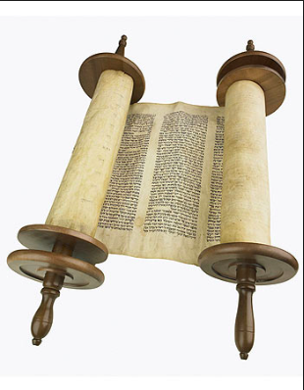
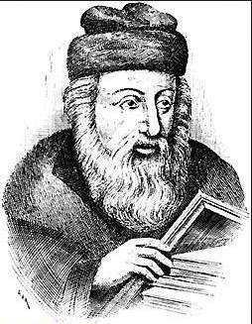
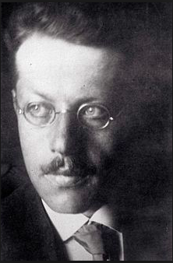
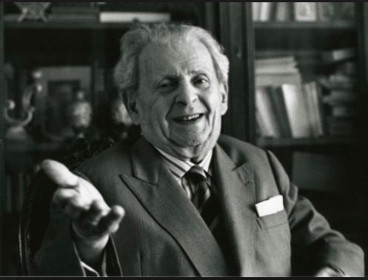
1300 BCE – 500 BCE
200 CE – 600 CE
1921 - 1995
Biblical Studies
Rabbinic Literature
Sifra, Genesis Rabbah, Jerusalem Talmud
Franz Rosenzweig (1886-1929)
& Emmanuel Levinas (1906-95)

Slide 9
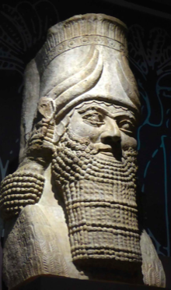
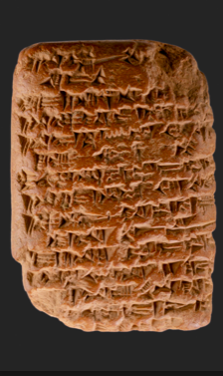
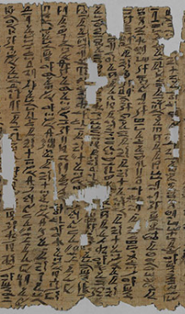

Slide 10
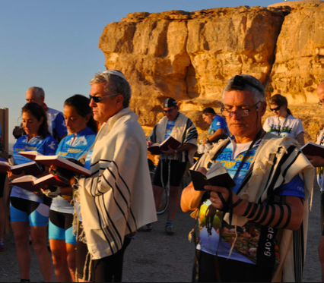
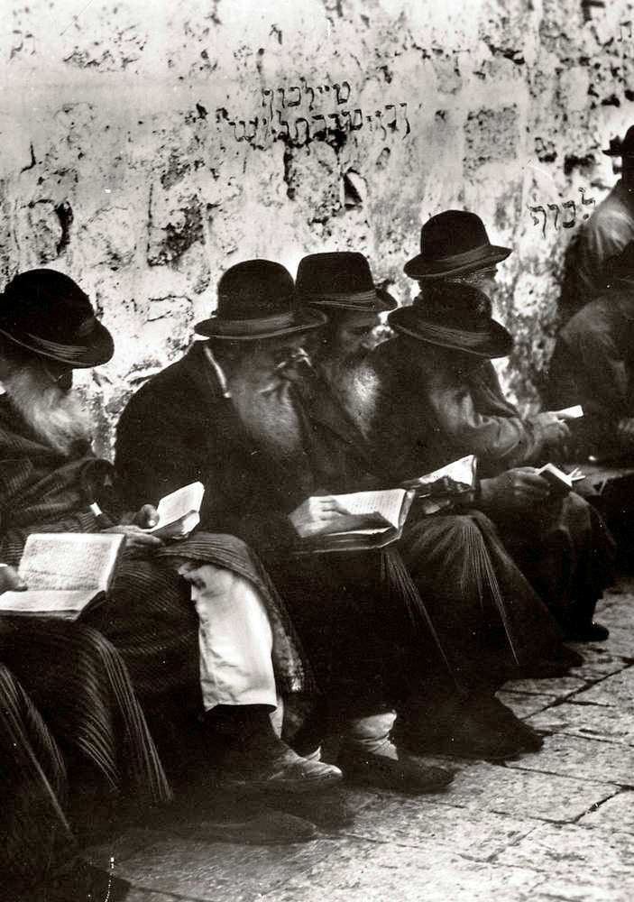
This Photo by Unknown Author is licensed under CC BY-SA

Slide 11
A Covenantal Love
Edict of succession: 660 BCE
"You will love, as yourselves, Assurbanípal"
Tel Amarna Letters: 1360-1332 BCE
“My lord, just as I love the king my lord, so (do) the king of Nuhašše, the king of Ni'i . . . - all these kings are servants of my lord. “

Slide 12
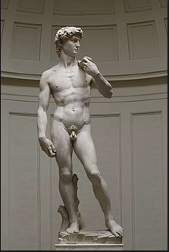
וַ֠יִּשְׁלַח חִירָ֨ם מֶֽלֶךְ־צ֤וֹר אֶת־עֲבָדָיו֙ אֶל־שְׁלֹמֹ֔ה כִּ֣י שָׁמַ֔ע כִּ֥י אֹת֛וֹ מָשְׁח֥וּ לְמֶ֖לֶךְ תַּ֣חַת אָבִ֑יהוּ כִּ֣י אֹהֵ֗ב הָיָ֥ה חִירָ֛ם לְדָוִ֖ד כָּל־הַיָּמִֽים
King Hiram of Tyre sent his officials to Solomon when he heard that he had been anointed king in place of his father; for Hiram had always been a friend of David.
(suggested translation: 'For Hiram had always been loyal to David)

Slide 13
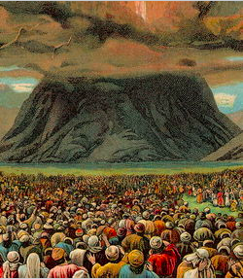

Slide 14
Via Negativa – what Love is NOT

Slide 15
Via Negativa – what Love is NOT
v.13: Do not defraud… Do not rob… Pay ontime
v.14: Do not insult the deaf, nor place stumbling block before the blind
v.15: No unfair decisions… don’t favour the poor or show deference to the rich…judge fairly
v.16: Do not deal basely…Do not profit from the blood of your fellow
v.17: Do not hate your kinsman…Reprove him but incur no guilt from him
v.18: Do not take vengeance nor bear a grudge….

Slide 16
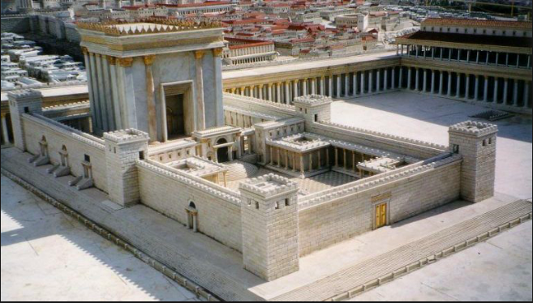

Slide 17
Love in Second Temple Times:
The Via Negativa
“That which is hateful to you, do not do unto others. All the rest is commentary. Go study! “
Hillel (c.100 BCE), BT Shabbat 31a
"See thou never do to another what thou wouldst hate to have done to thee by another."
Apocryphal Book of Tobit (Qumran) 4.16 (~200 BCE)

Slide 18
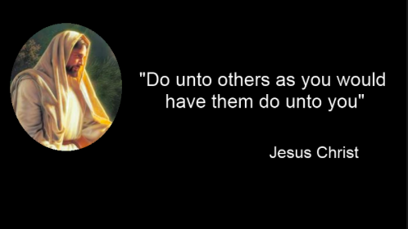
New Testament, Matthew 7:12

Slide 19
Summary so far
Torah
Love is Covenantal
Entered into by the ‘Assembly of Israel’
Your ‘neighbor’ is your peer in the Assembly
Covenant is to act benevolently and beneficently
Second temple
Love is Morality
Self-love is gold standard
Love is what is not hateful, vengeful etc.

Slide 20
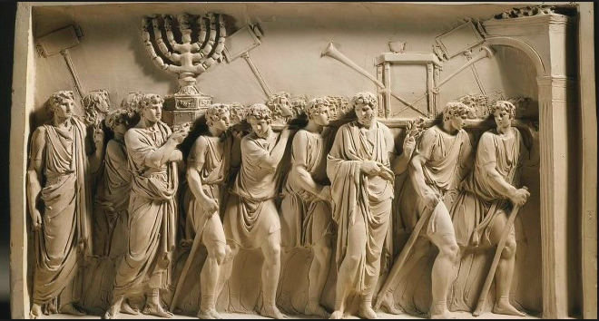

Slide 21
Mishnah: A new form of Jewish Identity
Jerusalem Temple → Yavneh
Sacrifice → Prayer
Priests → Rabbis
Geography → Halachah

Slide 22
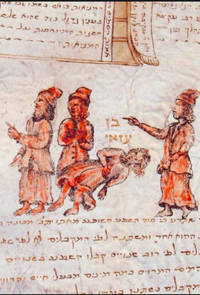
Akiva v. Ben Azzai debate
Sifra c250-300 CE
Genesis Rabbah c300-350 CE
Jerusalem Talmud c400-450 CE
New Testament: Matthew 22:33-37

Slide 23
The Greatest Principle of Torah
”And you shall love your neighbour as yourself.” Rabbi Akiva says: ‘This is an all-embracing principle in the Torah’.
Ben Azzai says: ‘"This is the numeration of the generations of Adam¹" — This is an even greater principle.’
Genesis 5.1

Slide 24
UNIVERSALISM
PARTICULARISM

Slide 25

Love is as important for Jews as Christians
Torah & Torah community
Security and safety
NOT shame, pain, destruction, humiliation
Love is:
What makes Torah rewarding in this world
For Jews as ‘one body, one soul’
But also = moral behavior for all humanity

Slide 26
20th Century
Franz Rosenzweig (1886-1929)
& Emmanuel Levinas (1906-1995)

Slide 27
Love in Rosenzweig
Love comes from God
Explains Existential Pain & Anxiety
Immanent Love is in Community
Love is the meaning of life

Slide 28
“Only a Lover can command one to Love”
1
Love me! With all your heart!
(Deuteronomy 6:8)
5
Soul finds answer: God’s love is found via loving other people
2
Self becomes ‘Soul’
4
Soul fears loss of God’s love and experiences anxiety
3
Soul’s love for (God) is unrequited and painful
(Song of Songs)

Slide 29
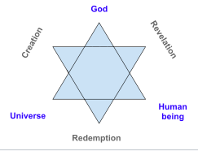
The neighbour-to-be-loved is whatever object is present ‘at the precise moment of love’

Slide 30
Levinas’s reworking of LTN
Love
Ethical Encounter
Neighbour
The (radically) Other
Self-regard
Obligation
God’s Command
Encountering the Other
Totalitarianism of Ontology
Pluralism of Ethics

Slide 31
Loving the Neighbour as Midrash for all of Torah
The constant, the entire refrain of Torah, Levinas explains, is that ‘there is always a priority of the other in relation to me’
Levinas - Of God Who Comes to Mind

Slide 32
Love busts the paradigms suggested by Christianity
Via Positiva
  Love is always Torah, always belonging to Torah community
Via Negativa
  That which is hateful to you, do not do to others
‘Others’ = Jews and non-Jews
Love of self
Self-love is the gold standard
Concept of low self-love is absent in these texts
Jews
Jews

Slide 33
Rabbinic Readings

Slide 34

Sifra
R. Tarfon said: I swear that there is no one in this generation who is able to reprove, (for the one he reproves is likely to attribute even worse faults to him).
R. Elazar b. Azaryah said: I swear that there is no one in this generation who is able to accept reproof…
R. Yochanan b. Nuri said: I call heaven and earth as witness for me that more than four or five times Akiva was beaten because of me before R. Gamliel, to whom I would complain about him, and he loved me all the more for it, in keeping with (Proverbs 9:8) "Do not reprove a scoffer lest he hate you."
Sifra, Kedoshin, C4:9

Slide 35
Sifra
“You shall not take revenge and you shall not bear a grudge against the children of your people”: You may take revenge of and bear a grudge against others (אחרים). ”
Sifra, Kedoshin, C4:12

Slide 36
Genesis Rabbah
Rabbi Tanchuma said in the name of Rabbi Eliezer and Rabbi Menachem in the name of Rav said... Ben Azzai said: “These are the generations of Adam" is a great principle in the Torah. Rabbi Akiva said: This is a great principle of the Torah: "You shall love your neighbor as yourself" (Lev. 19:18).
Thus, one should not say, “Since I am scorned, I should scorn my fellow as well; since I have been cursed, I will curse my fellow as well.”
Rabbi Tanchumah said, if you act thus, realize who it is that you are willing to have humiliated - "the one who was made in the likeness of God."
Rabbi Tanchuma says, “If you do so, you should know who are you scorning — ‘in the likeness of God He created him.’”
Genesis Rabbah 24:7

Slide 37
Y.Nedarim
[It is written: You should not take revenge or nurse hatred against your fellow countrymen.]
What is an example? Someone was cutting meat and laid the knife on his hand. Would he in turn cut the other hand?
Y.Nedarim 9:4

Slide 38
Y.Nedarim
(Mishnah Nedarim 9:4) "Maybe he will become poor and you will not be able to support him?"
Rabbi Zeira said: Poverty is frequent. There was once a man with a case against a wealthy man, which came before Rav for judgment. Rav sent after him [the wealthy man]. He said, "For him I am asked to come for judgment? Even if all the camels of Arabia came together, they could not carry the bolts of my treasures."
Rav heard this and said, "Is he so proud of what is not his? May his wealth be reduced."
Just then an order was issued by the king that he and whatever belonged to him should be relinquished to the treasury.
The rich man came to Rav and said to him, "Pray for me, that he will return my soul [i.e., let me live]."
Rav prayed for him and he gave him back his life.
Y.Nedarim 9:4

